Slide 1

Testing
Croitoru Dan Nicolae

Slide 2
About the application
Skype is an IP telephony service provider that enables people to make and receive free voice and video calls over the internet using a computer, web browser, or mobile phone.
In addition to standard telephone calls, Skype enables file transfers, texting, video chat and video-conferencing. The service is available for desktop computers, notebook and tablet computers and other mobile devices, including mobile phones.
Is it mostly used on desktops

Slide 3
Test Approach
Reactive: Since the application is already in production, testing cou’t take place before the implementation
Different Test approaches: Methodical:
Test Cases were planned in consideration to negative scenarios
Analysing and researching: Experiences and reports from other users were taking into consideration.

Slide 4
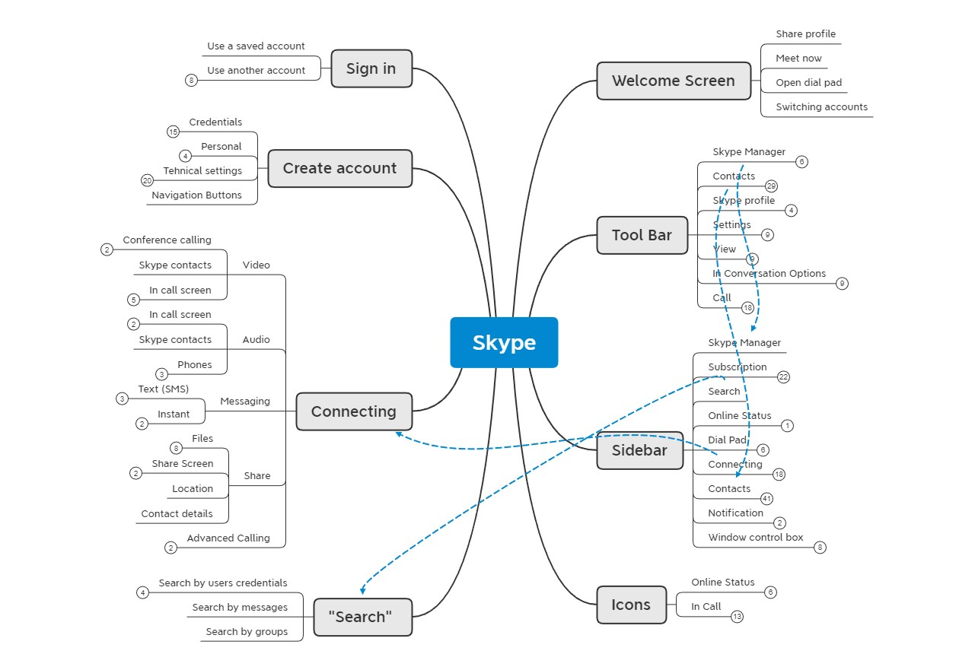

Slide 5
Tools
Tools used for testing: Edifier G20 headset with microphone, Acer Aspire integrated dual digital microphone and speakers, mail accounts ( Yahoo, Gmail and Yandex )
The mindmap was created in Xmind and it coveres all the main funtionalities of Skype for desktop.

Slide 6
Testing types
The most frequent testing types applied were Functional Testing, Exploratory, Negative, UI and Usability. Also a Smoke Testing session was conducted at the beginning of the project and no bugs have been found.
Exploratory testing was performed for important functionalities (concentrating on negative scenarios).
The rest of the bugs were identified by performing Negative Testing.

Slide 7
Test cases overview
Test Cases were created corespondly to the mindmap and were structured based on the main functionalities of Skype
The following testing techniques were used:
Boudaries values analysis, ex: in case of maximum characters alowed in text fields (chat section)
Equivalence partitioning, ex: in case of calendar dates

Slide 8
Bugs
During the testing, 8 bugs have been found, from which 2 are posing a security threat “critical”:
0031179 - [Registration].[email verification.code] - a way to pass the security check with invalid code
0031186 - [Registration].[email verification.code] - security check dissapears after passing it one time
From the rest of the bugs, only one bug pose a “major” severity (0031180) and the rest are “normal”

Slide 9
Test cases results
100 % of the Test Cases were executed, from which 93% passed and 7% were failed. Most of the failed test cases are related to the chat window functionality and Sign in/Create.
91 test cases have been written in total, from which only 6 Test Cases failed
Examples of Test Cases:
Verify that the password cannot be copy-pasted
Verify that the "Date of birth" field should not allow dates greater than current date

Slide 10
Conclusions
Considering the number of high severity/security bugs identified, fixing of the critical bugs is recommended. Few bugs that can create a rather uncomfortable experience for users should be as well noticed and tended.
Concerning the usability, overall , Skype is convenient and easy tool to use and install and can be deemed to be fit for purpose.
From the perspective of stability, I would give a score of 8 out of 10 for the reason of relying heavily on a very good internet connection.

Slide 11
What I have learnt?
Considering testing, a complex application like Skype takes time and more awareness in planning.
Concentrating on critical points in a short time
A proper mindmap is the road to succes in understanding an application
Regardless of the enviroment (UAT, PROD) and version of the build, critical bugs can still be found

